Slide 1



Higher Education and the
University of Oxford
Rowan Anderson
St Hilda’s College
University of Oxford
Notes:
This presentation will elaborate on some of the things we mentioned in the first half of the day and put them in the context of the rest of the application.

Slide 2




Today’s talk
Why go to university?
What is Oxford?
What can I do now to prepare for
applying?
Q&A (plus application info)
Work Experience
Future plans
Extra curricular activities should focus on transferable skills

Slide 3
ALL ABOUT
UNIVERSITY

Slide 4
Why do people go to university?
Independence
Learning
Meet new people
Skills
To enjoy it
Career

Slide 5
There are over 50, 000 courses to choose from at UK universities
There are approximately 130 universities in the UK
University study is split into three terms of around 10 weeks a term. Longer holidays!
University:
Quick Facts
University is one of your options when you finish school.
Universities are either campus, city or collegiate universities
You study one subject, occasionally two related subjects
You don’t need to know what you’re going to do after university!

Slide 6







































Types of University
?
City universities
?
Collegiate universities
?
Campus universities

Slide 7
ALL ABOUT OXFORD

Slide 8
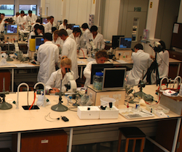


Academic Life at Oxford
Expert Tutors
Amazing Resources
Lectures
Classes/Seminars
Lab Work/Fieldwork
Tutorials
Independent Study
Exams

Slide 9
Undergraduate courses include…
Archaeology & Anthropology
Computer Science
History
Modern Languages
Biochemistry
Earth Sciences
History of Art
Music
Biology
Economics and Management
Human Sciences
Oriental Studies
Biomedical Sciences
Engineering Science
Law
Philosophy, Politics & Economics (PPE)
Chemistry
English Language & Literature
Materials Science
Physics
Classical Archaeology & Ancient History
Fine Art
Mathematics
Psychology
Classics
Geography
Medicine
Theology and Religion
ox.ac.uk/apply
ox.ac.uk/courses

Slide 10

…plus over a hundred joint courses
English and History
Mathematics and Philosophy
History and Politics
Physics and Philosophy
History and Economics

Slide 11

Career Opportunities
Oxford is…
lifelong expert career advice
Over 9000 opportunities on website over past year
100s of local and global internships
studying at Oxford gives you an impressive and highly sought-after skill set

Slide 12




Oxford is…
the University
Sets content and structure of courses
Organises lectures, seminars and lab work
Sets and marks exams
Awards degrees
Provides student services such as counselling and careers
Colleges
Provide accommodation, meals, common rooms, sports and social facilities
Provide pastoral care
Organise tutorial teaching
Offer students support of personal tutor
Select students for admission with departments
Every student is a member of a college as well as the university

Slide 13

the tutorial system
Oxford is…
Every student at Oxford has a chance to meet with an expert in their field of study approximately once a week.
Small groups of students with your tutor, discussing a topic in depth.
Individualised learning
Tutors can also provide additional academic support

Slide 14
Oxford Stereotypes
“only for posh people”
“more expensive than other universities”
“for people who are a genius”
“where everyone rows / rides a bike”
“hard work and the social life is worse”

Slide 15

What university costs
ox.ac.uk/funding

Slide 16
Finance at Oxford
“it’s no more expensive to study at Oxford than at any other University….our world –class resources , extensive bursaries and college provision actually keep living costs down”
Tuition Fees
Maintenance Support
Bursary Support: income assessed
Capped by the government
Same at almost all universities
Available for all from the government
Repaid with tuition fees
Oxford Bursaries and Crankstart Scholarships
Check www.ox.ac.uk/funding for more information
https://www.ox.ac.uk/students/fees-funding/search/undergraduate

Slide 17
What universities are looking for...
academic ability and potential
self-motivation and commitment
to study
ability to think clearly, critically, independently and flexibly
enthusiastic engagement with new ideas and chosen subject

Slide 18
THE APPLICATION

Slide 19
Applying to University
Academic Achievement
Contextual Data
Interviews
Personal Statement
Teacher References
Admissions Tests
Written Work

Slide 20
What Next?
Work hard for your GCSEs!
Read around your subjects(s) –
what interests you?
Talk to parents, teachers, careers advisors
Look up courses (UCAS, university websites)
Use all this research when deciding A Level options!

Slide 21
Extra-curricular v Super-curricular
‘Super-curricular’ activities
Summer schools
Work experience (Medicine place more emphasis on work experience)
Public Lectures
Voluntary work
Competitions
Enrichment activities in the local area –publicly accessible opportunities
Read newspapers, journals, books
Is it worthwhile? Is it relevant to the course? What have you learnt? Or is it just ticking a box?
Extra-curricular activities should focus on transferrable skills/attributes, e.g. time management, organisational skills, capacity to cope with increased workload
Work Experience
Future plans
Extra curricular activities should focus on transferable skills
ox.ac.uk/apply

Slide 22

“Super-Curricular”

Slide 23

Home of Big Questions
An innovative new digital outreach portal from the University of Oxford.
The ‘Home of Big Questions.’ It aims to engage those from 11 to 18 years with debates and ideas that tackle complex ideas across a wide range of subjects.
Raising aspirations
Promoting broad thinking
Stimulating intellectual curiosity
Using the latest research
ox.ac.uk/apply
Notes:
Oxplore is an innovative digital outreach portal from the University of Oxford.
As the ‘Home of Big Questions’ it aims to engage those from 11 to 18 years with debates and ideas that go beyond what is covered in the classroom.
Big questions tackle complex ideas across a wide range of subjects and draw on the latest research undertaken at Oxford. At least 3 or 4 academic themes are brought into each big question.
Oxplore aims to realise aspirations, promote broader thinking and stimulate intellectual curiosity.
Our Big Questions reflect the kind of thinking students undertake at universities like Oxford. Everything on Oxplore draws on the University of Oxford’s expertise in everything from archaeology to zoology to offer approaches to challenges and questions underpinned by the latest thinking and research.
Competitions – Students can submit comments and questions and win prizes if their big question is selected

Slide 24

Academic ability and potential
Subject requirements
Particular backgrounds
Genuine subject interest
NO
YES
Irrelevant extra-curricular activities
Particular school types
Learning/ assessment style
What are we interested in?

Slide 25




UNIQ Summer
expanding by 500 places to 1,350 students
students spend a week at Oxford, studying their chosen subject
choice of over 30 subjects across 17 colleges
admissions advice
experience student life at Oxford
UNIQ Spring
100 places at a three-day Oxford residential during Easter holidays
academic sessions and admissions support
UNIQ Digital
1000 places on the online learning platform
online mentoring, encouragement and advice
ox.ac.uk/apply

Slide 26
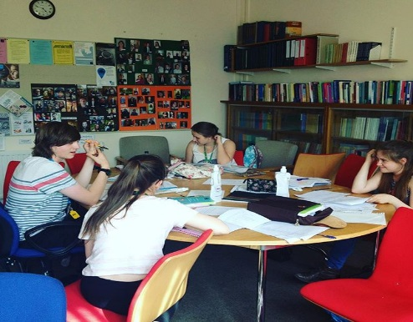
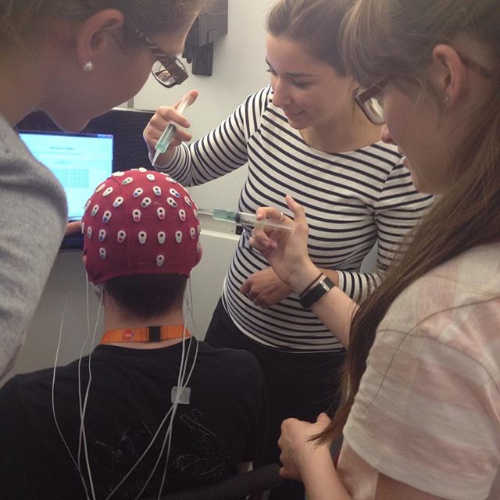

Open to students currently in their first year of A-Levels (or equivalent) at UK state schools/colleges/sixth forms/academies
Applications for the 2025 Summer School open around December
Selection criteria is based on:
  Academic attainment at GCSE/National 5 (or equivalent) with a strong preference for 8 and 9/Distinction*/1 grades
  Home postcode data and polar 3 data
  Personal statement
www.uniq.ox.ac.uk
www.uniq.ox.ac.uk

Slide 27
Any Questions?
Please email outreach@st-hildas.ox.ac.uk

Slide 28
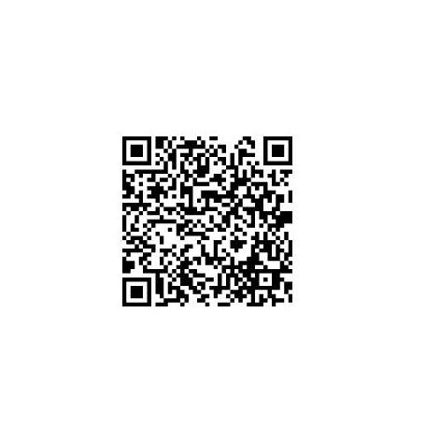
Participant Forms and Feedback

Slide 29
Choose course and college
Start UCAS
application
Test
registration
Submit application
by 15 Oct
Interview
Result of application
Written work / tests
Choose ‘firm’ and ‘insurance’ choices
Exam results/ confirmation
Start university!
www.ucas.com www.ox.ac.uk/apply
Notes:
29

Slide 30
What IS a Personal Statement?
A Personal Statement is a short essay which demonstrates your academic interests and personal qualities …
… to highlight your suitability and enthusiasm for your University course
Work Experience
Future plans
Extra curricular activities should focus on transferable skills
ox.ac.uk/apply

Slide 31
Personal Statement
Getting started
What is an (academic) area of interest for you?
What was the activity? Reading a book, watching a TV programme, listening to a podcast, going to a lecture, visiting a museum or gallery, field-trip, watching a video online, reading an article ...
What did you think about it? What did you find interesting about it? How did it relate to other things you know about? What did you gain from it? What did you do next?
How did it make you a better candidate for the course? You need to know what your university course will involve for this – an opportunity to show you are motivated and understand what university study will involve.
Work Experience
Future plans
Extra curricular activities should focus on transferable skills
ox.ac.uk/apply

Slide 32
Selection Criteria
EARTH SCIENCES Students are selected on the basis of ability and potential in the following areas:
Reasoning ability; aptitude for analysing and solving problems using logical and critical approaches
Mathematical ability and potential
Independence and creativity of thought, lateral thinking and hypothesis generation
Capacity to absorb and use new ideas; ability to apply familiar ideas to unfamiliar situations
Spirit of enquiry: keenness to understand the reasons for observations; depth; tendency to look for meaning; enthusiasm and curiosity in science
Observation: accurate, critical, quantitative
Appreciation of the field-based, laboratory and theoretical nature of the Earth Sciences
ox.ac.uk/criteria

Slide 33
Personal Statement
Show, don’t tell: “As a science based student I approach all of my work as logically as I can. I am neat, thorough and pay great attention to detail. This has been especially useful in mathematics as it has enabled me to show my reasoning in clearly thought out steps. I have good self-motivation and work well independently.”
Work Experience
Future plans
Extra curricular activities should focus on transferable skills
Keep it Personal: “The medical profession combines knowledge and wisdom from just about every aspect of life which is directed towards helping humanity. A physician is not just part of the heath care team but the leader of the health care team. He is free to practice broadly or to acquire a specialty of his own choosing. Thus medicine offers the challenges and fulfilment that I am seeking in a career.”
ox.ac.uk/apply

Slide 34

Personal Statement
DO
Explain what interested you/why you found something interesting
Be specific about your interests within your subject
Be yourself: tell the truth about your interests
Sell yourself!
Proof-read
Limit the number of people whose advice you ask
Re-read before interview
DON’T
Copy excerpts from anyone else’s statement. UCAS uses plagiarism detection software.
Feel the need to be dramatic to be memorable
Repeat qualification information, or anything else already included in your application
List achievements or interests without evaluating them
List skills (SHOW, don’t tell!)
80% academic including super-curricular
20% extra-curricular: focus on transferable skills
Work Experience
Future plans
Extra curricular activities should focus on transferable skills
ox.ac.uk/apply

Slide 35
Personal Statement
Avoid Repetition:
“I am doing A Level English, History and Geography. I got 5 A*s and 3 As in my GCSEs. Studying History at A-level has helped develop my writing skills and critical analysis… Attending this Study Day helped develop my writing skills and critical analysis…”
Work Experience
Future plans
Extra curricular activities should focus on transferable skills
ox.ac.uk/apply

Slide 36


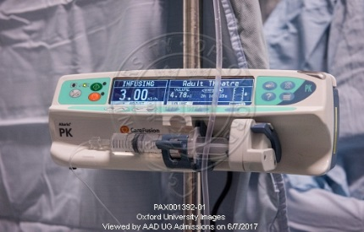

University of Oxford tests
Our admissions tests are timed, written exams which are designed to show us how applicants think:
how they analyse and solve difficult questions
how they apply their knowledge to texts or problems they won’t have encountered before
They are written by academics
Content is revised and the tests are reviewed annually.
You need to register yourself to take your admissions test.
ox.ac.uk/apply

Slide 37
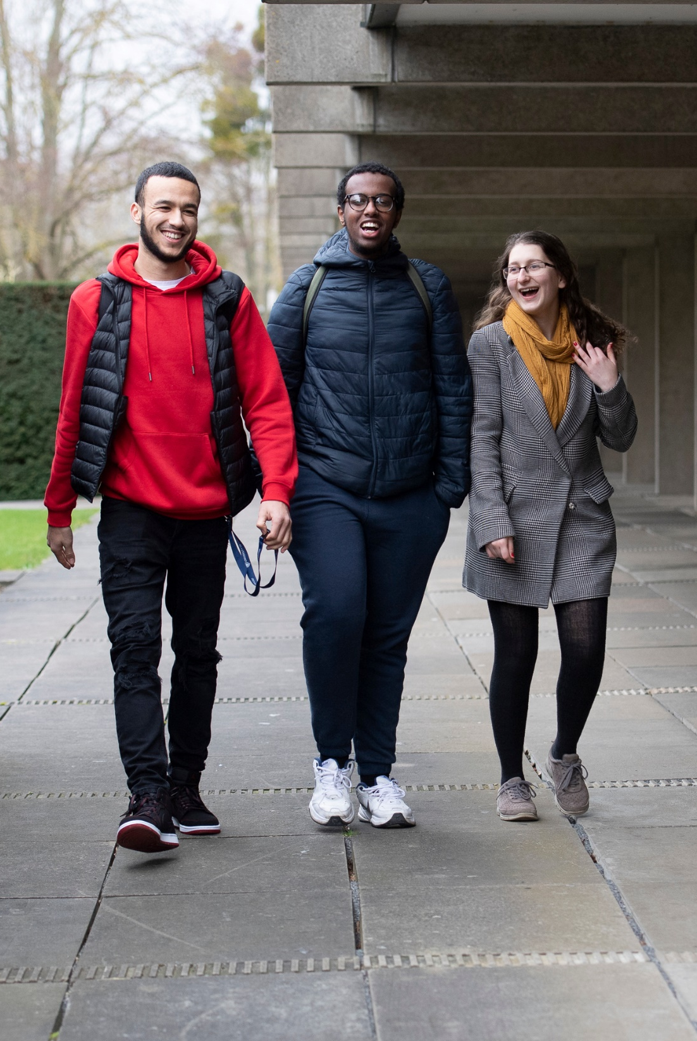
Test Preparation
Specimen and past papers are available for all of the tests, offering applicants the opportunity to:
familiarise themselves with the test content, level and format
get to know the different types of questions they may be asked
test themselves under timed conditions
review answers
ox.ac.uk/apply

Slide 38
Written Work
Which courses?
Archaeology and Anthropology, Classical Archaeology and Ancient History, Classics, English, European and Middle Eastern Languages, Fine Art (portfolio), History, History of Art, Modern Languages, Music, Asian and Middle Eastern Studies, Theology & Religion –and joint schools for all of the above.
What do I submit?
One or two essays from school or college that demonstrate your analytical, reasoning, language and writing skills.
Usually no more than 2000 words (extracts from longer pieces are sometimes accepted). Original work marked by a teacher, and not re-written or corrected.
Check course page for specific criteria/subject focus.
When do I submit it?
Usually by 10 November

Slide 39
Interviews
Practicalities
2-3 interviews of 20-30 minutes
Academic in focus
Combination of existing knowledge and new material
No trick questions or hidden agendas
Possible Content:
Personal statement
Written work
A Level material
A text, picture, object or problem
Entirely new material
www.ox.ac.uk/interview

Slide 40

Interview Tips
Focus is on how you think
Get used to thinking out loud
Give examples
Listen to what the tutor says
Don’t launch into prepared speeches
Don’t worry if you make mistakes
Don’t panic and take your time
Ask for clarification if you need it
www.ox.ac.uk/interview

