Slide 1

Anti-Bullying

Slide 2
The Anti-Bullying Committee
What do we do?
Help everyone to recognise bullying
Understand how we are affected by bullying
Help pupils report bullying and get help
Promote Anti-Bullying as our ethos at Swanmore

Slide 3
Aims of this presentation
To tell you what the committee does
To define what bullying is
To share ways to report bullying and get help

Slide 4
What we do
We meet every Thursday tutor time to discuss what is happening around school and how we can help you, the pupils feel safer and happier.
Every year we as a school promote Anti-Bullying Week in November.
All our committee members have had anti-bullying training

Slide 5
Anti-Bullying Ambassadors
Amelia C 11r1
Shanna L 11r3
Joey S 11r3
Olivia M 11r7
Archie HL 10r8
Hannah V 10r11

Slide 6
Who to talk to?
Upstanders Year 9
Emily B 9r1 Jemima S 9r7
Yasmine P 9r2 Jack S 9r8
Lyla N 9r3 Stephen V 9r9
Daniel W 9r9
Rosie M 9r4
John S 9r4
Georgia S 9r4
Catherine C 9r5
Kyra H 9r5
Lulu H 9r5
Liam L 9r6
Upstanders Year 10
Phoenix P 10r2
Michael J 10r3
Ben L 10r3
Taya R 10r3
Freddie S 10r3
James G 10r4
Sian D 10r7
Elle S 10r7
Erin C 10r11
Anna L 10r11
Upstanders Year 11
Lewis Cobb 11r9
George Cambell 11r9

Slide 7
Year 8 Forum Members
Jess A-C 8r1
Sam W 8r2
Ophelia C 8r3
Aine Sc 8r4
Evie H 8r5
Molly E 8r6
Rowan G 8r7
Delilah P 8r8
Lewis M 8r9
Gavin B 8r10

Slide 8
Trained Senior Prefects in Year 11
Thomas A
Emily A
Erin |B
Alex C
Jasper C
Harriet C
Minke DT
Samuel H
Callum H
Jack L
Harvey O
Andrew P
Isabelle T
Evie T
David W

Slide 9
How does Swanmore define bullying?
“Repeated, negative behaviour that is intended to make others feel upset, uncomfortable or unsafe.”
Repeated Negative Intended

Slide 10
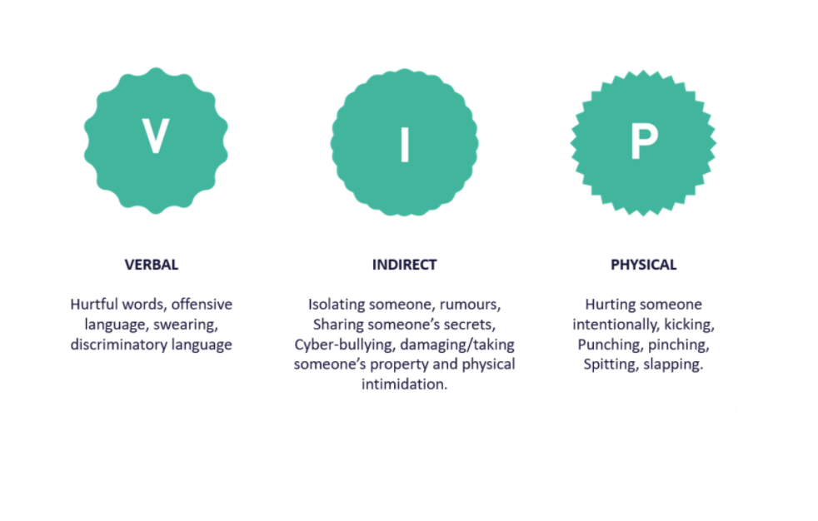
Notes:
We speak about these three types of bullying in everyone of our assemblies.
And we use the acronym VIP
V-stands for Verbal- this is the repeated negative use of speech, sign language, or verbal gestures to intentionally hurt others.
I- stands for Indirect- this is the repeated negative use of actions, which are neither physical nor verbal, to intentionally hurt others.
P-stands for Physical- this is the repeated negative use of body contact to intentionally hurt others.

Slide 11
Being An Upstander
An upstander is somebody who doesn't just watch bullying but does something about it, by getting help in some way.
It doesn't have to be a big action and you don’t have to solve the issue yourself.

Slide 12
So what should you do?
Tell someone:
Any member of Anti-Bullying Committee
Any Anti-Bullying Ambassador
Any member of staff
Head Boy or Head Girl or Senior Prefects
Or use the anti-bullying email address
antibullying@swanmore-sec.hants.sch.uk

Slide 13
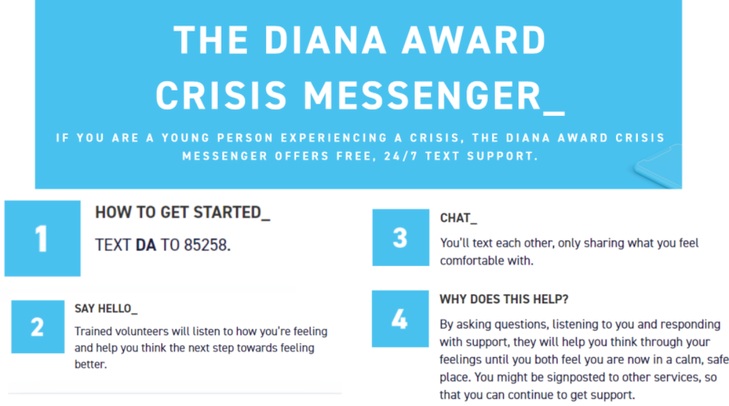

Slide 14
